Slide 1
Stochastic Gradient Descent

Slide 2
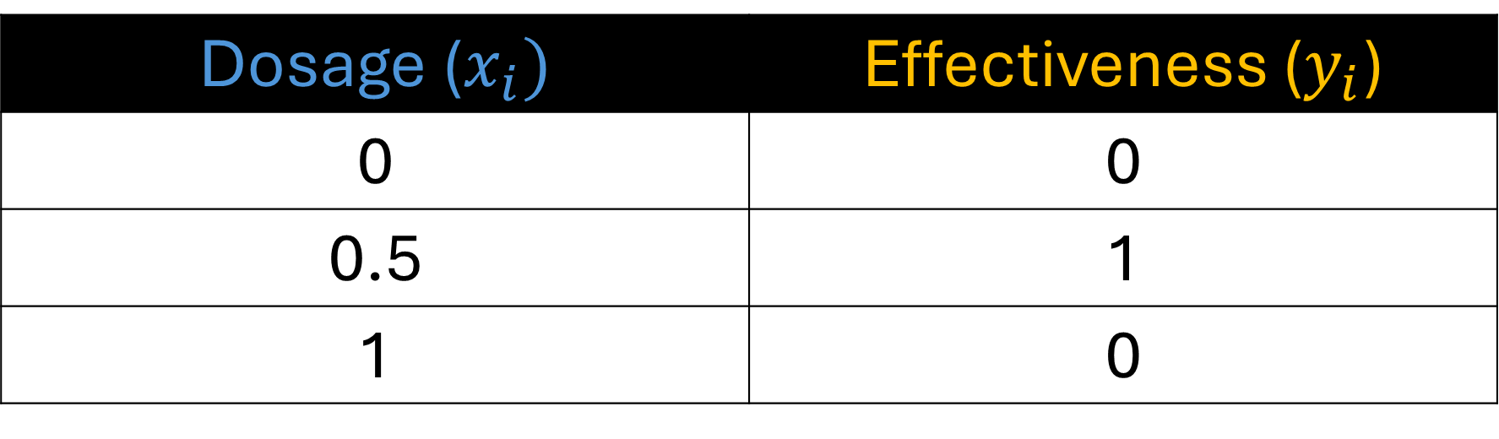
Dosage ($x_{i})$ | Effectiveness ($y_{i}$)
0 | 0
0.5 | 1
1 | 0
In our previous examples, we created a neural network to predict if a medicine dosage is effective for a patient.

Slide 3
Dosage ($x_{i})$ | Effectiveness ($y_{i}$)
0 | 0
0.5 | 1
1 | 0
And we only used three samples to train our neural network

Slide 4

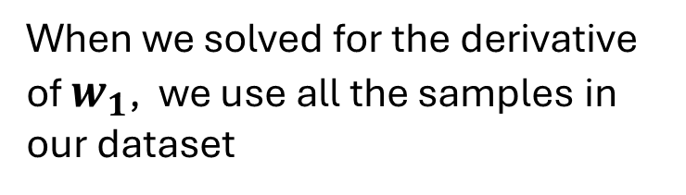
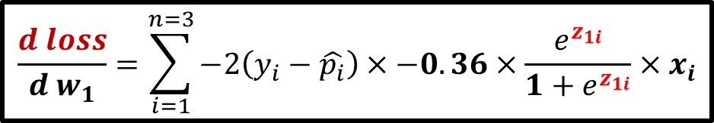
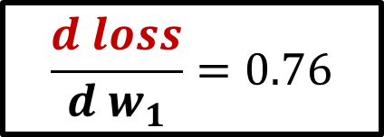
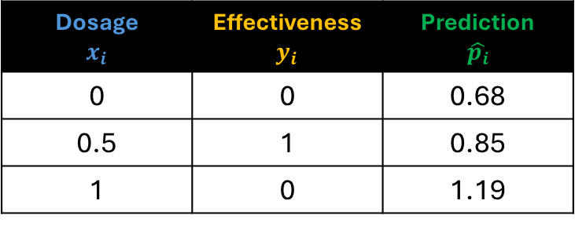
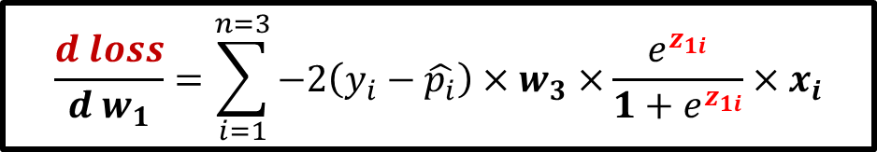
Dosage $$x_{i}$$ | Effectiveness $y_{i}$ | Prediction $$\hat{p_{i}}$$
0 | 0 | 0.68
0.5 | 1 | 0.85
1 | 0 | 1.19
$$\frac{d loss}{{d w}_{1}}=\sum_{i=1}^{n=3}{−2\left(y_{i}−\hat{p_{i}}\right){×w}_{3} ×\frac{e^{z_{1i}}}{1+e^{z_{1i}}}×x_{i}}$$
$$\frac{d loss}{{d w}_{1}}=\sum_{i=1}^{n=3}{−2\left(y_{i}−\hat{p_{i}}\right)×−0.36×\frac{e^{z_{1i}}}{1+e^{z_{1i}}}×x_{i}}$$
When we solved for the derivative of $w_{1}$, we use all the samples in our dataset
$$\frac{d loss}{{d w}_{1}}=−2\left(0−0.68\right)×−0.36×\frac{e^{0}}{1+e^{0}}×0$$
$+$ $−2\left(1−0.85\right)×−0.36×\frac{e^{1.37}}{1+e^{1.37}}×0.5$
+ $−2\left(0−1.19\right)×−0.36×\frac{e^{2.74}}{1+e^{2.74}}×1$
$$\frac{d loss}{{d w}_{1}}=0.76$$

Slide 5
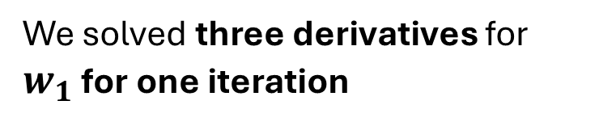
Dosage $$x_{i}$$ | Effectiveness $y_{i}$ | Prediction $$\hat{p_{i}}$$
0 | 0 | 0.68
0.5 | 1 | 0.85
1 | 0 | 1.19
$$\frac{d loss}{{d w}_{1}}=\sum_{i=1}^{n=3}{−2\left(y_{i}−\hat{p_{i}}\right){×w}_{3} ×\frac{e^{z_{1i}}}{1+e^{z_{1i}}}×x_{i}}$$
$$\frac{d loss}{{d w}_{1}}=\sum_{i=1}^{n=3}{−2\left(y_{i}−\hat{p_{i}}\right)×−0.36×\frac{e^{z_{1i}}}{1+e^{z_{1i}}}×x_{i}}$$
We solved three derivatives for $w_{1}$ for one iteration
$$\frac{d loss}{{d w}_{1}}=−2\left(0−0.68\right)×−0.36×\frac{e^{0}}{1+e^{0}}×0$$
$+$ $−2\left(1−0.85\right)×−0.36×\frac{e^{1.37}}{1+e^{1.37}}×0.5$
+ $−2\left(0−1.19\right)×−0.36×\frac{e^{2.74}}{1+e^{2.74}}×1$
$$\frac{d loss}{{d w}_{1}}=0.76$$

Slide 6
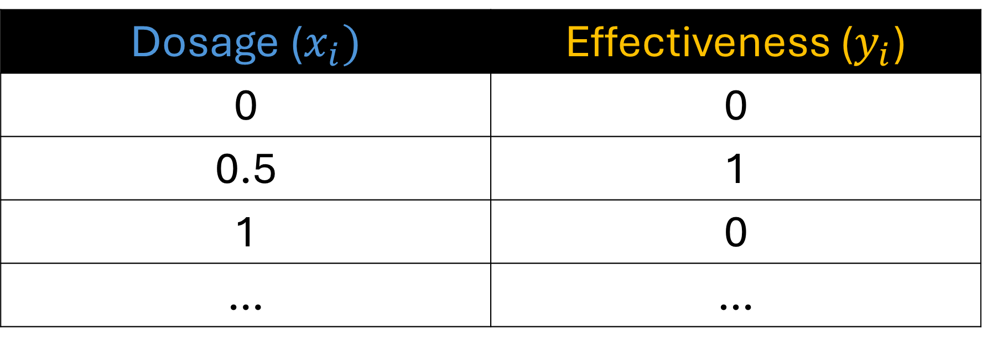
Dosage ($x_{i})$ | Effectiveness ($y_{i}$)
0 | 0
0.5 | 1
1 | 0
… | …
Real world datasets usually contains thousands or up to a million samples or records.

Slide 7
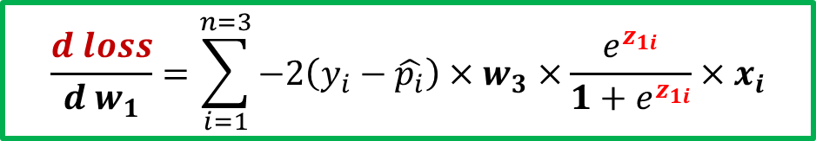
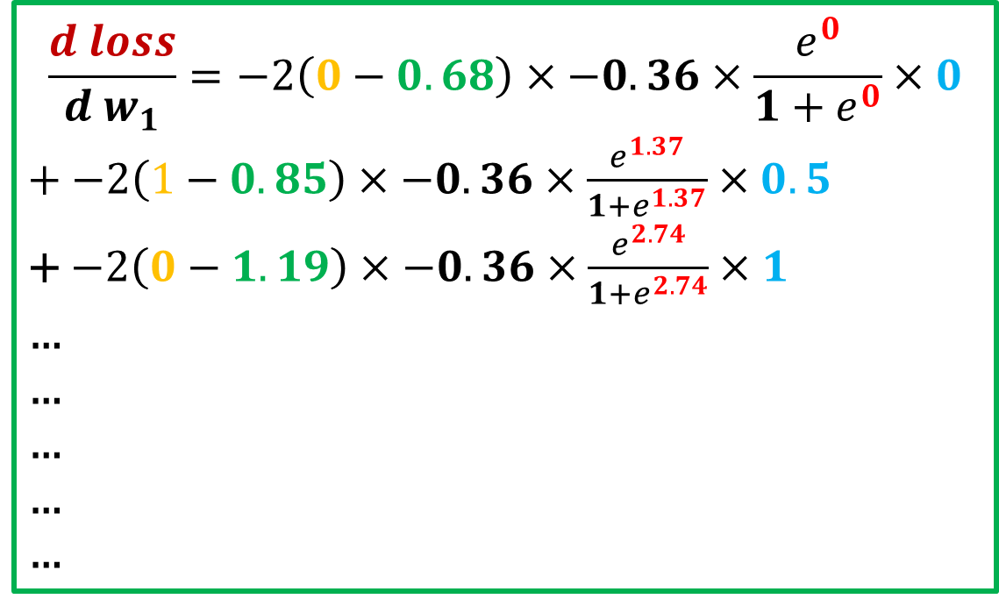
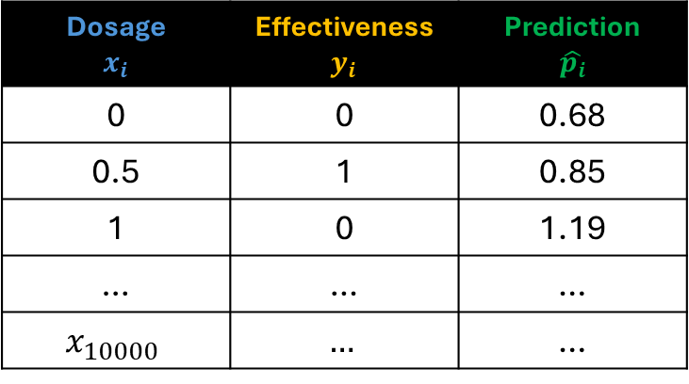
Dosage $$x_{i}$$ | Effectiveness $y_{i}$ | Prediction $$\hat{p_{i}}$$
0 | 0 | 0.68
0.5 | 1 | 0.85
1 | 0 | 1.19
… | … | …
$$x_{10000}$$ | $$…$$ | …
$$\frac{d loss}{{d w}_{1}}=\sum_{i=1}^{n=3}{−2\left(y_{i}−\hat{p_{i}}\right){×w}_{3} ×\frac{e^{z_{1i}}}{1+e^{z_{1i}}}×x_{i}}$$
$$\frac{d loss}{{d w}_{1}}=−2\left(0−0.68\right)×−0.36×\frac{e^{0}}{1+e^{0}}×0$$
$+$ $−2\left(1−0.85\right)×−0.36×\frac{e^{1.37}}{1+e^{1.37}}×0.5$
+ $−2\left(0−1.19\right)×−0.36×\frac{e^{2.74}}{1+e^{2.74}}×1$
…
…
…
…
…
If we have 10,000 training samples, we will be computing 10,000 derivatives

Slide 8
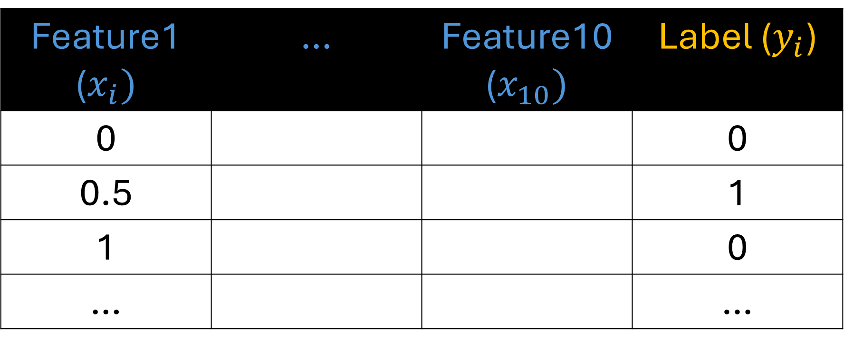
Feature1 ($x_{i})$ | … | Feature10 ($x_{10})$ | Label ($y_{i}$)
0 |  |  | 0
0.5 |  |  | 1
1 |  |  | 0
… |  |  | …
And if our dataset has 10 features, that would be 10,000 * 10 = 100,000 computations per iteration

Slide 9











$$x_{1}$$
$$x_{2}$$
$$x_{3}$$
$$x_{4}$$
$$p_{i}$$
$$x_{5}$$
$$x_{6}$$
$$x_{7}$$
$$x_{8}$$
$$x_{9}$$
$$x_{10}$$

Slide 10
$$x_{1}$$
$$x_{2}$$
$$x_{3}$$
$$x_{4}$$
$$p_{i}$$
$$x_{5}$$
$$x_{6}$$
$$x_{7}$$
$$x_{8}$$
$$x_{9}$$
If we set the number of iterations/epoch to 1000, that would be 100000000 computations to complete the algorithm
$$x_{10}$$

Slide 11
$$x_{1}$$
$$x_{2}$$
$$x_{3}$$
$$x_{4}$$
$$p_{i}$$
$$x_{5}$$
$$x_{6}$$
$$x_{7}$$
$$x_{8}$$
$$x_{9}$$
That is pretty much an overhead and this is why gradient descent is slow on huge data.
$$x_{10}$$

Slide 12
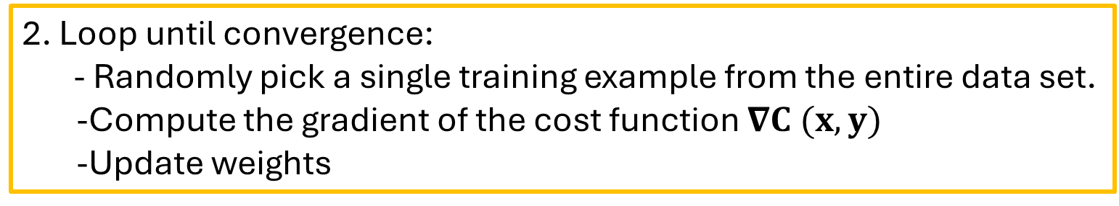
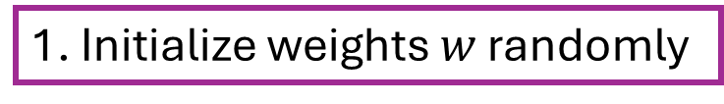
Stochastic Gradient Descent
1. Initialize weights $w$ randomly
2. Loop until convergence:
- Randomly pick a single training example from the entire data set.
-Compute the gradient of the cost function $∇C (x, y)$
-Update weights
3. Return weights

Slide 13
Stochastic Gradient Descent
In SGD, since only one sample from the dataset is chosen at random for each epoch, the path taken by the algorithm to reach the minima is usually noisier than your typical Gradient Descent algorithm.

Slide 14
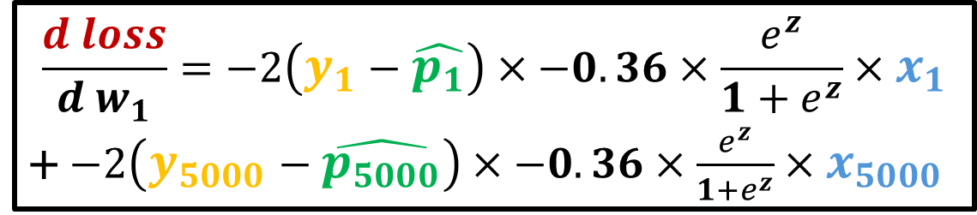
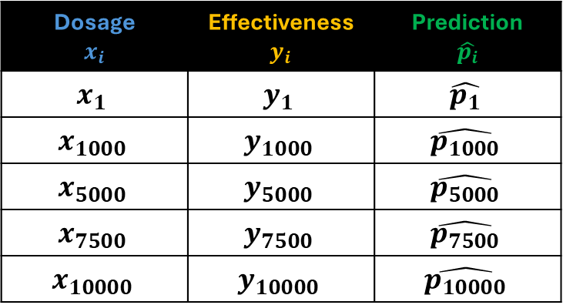
Stochastic Gradient Descent
Epoch 1
$$\frac{d loss}{{d w}_{1}}=−2\left(y_{1}−\hat{p_{1}}\right)×−0.36×\frac{e^{z}}{1+e^{z}}×x_{1}$$
+ $−2\left(y_{5000}−\hat{p_{5000}}\right)×−0.36×\frac{e^{z}}{1+e^{z}}×x_{5000}$
Dosage $$x_{i}$$ | Effectiveness $y_{i}$ | Prediction $$\hat{p_{i}}$$
$$x_{1}$$ | $$y_{1}$$ | $$\hat{p_{1}}$$
$$x_{1000}$$ | $$y_{1000}$$ | $$\hat{p_{1000}}$$
$$x_{5000}$$ | $$y_{5000}$$ | $$\hat{p_{5000}}$$
$$x_{7500}$$ | $$y_{7500}$$ | $$\hat{p_{7500}}$$
$$x_{10000}$$ | $$y_{10000}$$ | $$\hat{p_{10000}}$$

Slide 15
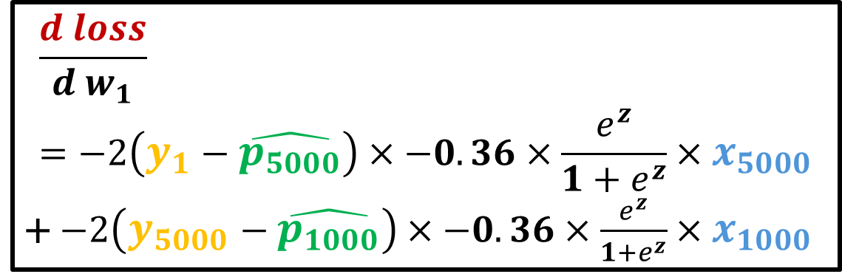
Stochastic Gradient Descent
Epoch 2
$$\frac{d loss}{{d w}_{1}}=−2\left(y_{1}−\hat{p_{5000}}\right)×−0.36×\frac{e^{z}}{1+e^{z}}×x_{5000}$$
+ $−2\left(y_{5000}−\hat{p_{1000}}\right)×−0.36×\frac{e^{z}}{1+e^{z}}×x_{1000}$
Dosage $$x_{i}$$ | Effectiveness $y_{i}$ | Prediction $$\hat{p_{i}}$$
$$x_{1}$$ | $$y_{1}$$ | $$\hat{p_{1}}$$
$$x_{1000}$$ | $$y_{1000}$$ | $$\hat{p_{1000}}$$
$$x_{5000}$$ | $$y_{5000}$$ | $$\hat{p_{5000}}$$
$$x_{7500}$$ | $$y_{7500}$$ | $$\hat{p_{7500}}$$
$$x_{10000}$$ | $$y_{10000}$$ | $$\hat{p_{10000}}$$

Slide 16
 | Stochastic Gradient Descent | Gradient Descent
Dataset Usage | Uses a single random sample at each iteration. | Uses the entire dataset (batch) at each iteration.
Computational Efficiency | Computationally less expensive per iteration, as it processes fewer data points. | Computationally more expensive per iteration, as it processes the entire dataset.
Convergence | Faster convergence due to frequent updates. | Slower convergence due to less frequent updates.
Noise | High noise due to frequent updates with a single or few samples. | Low noise as it updates parameters using all data points.
Memory | Requires less memory as it processes fewer data points at a time. | Requires more memory to hold the entire dataset in memory.

Slide 17
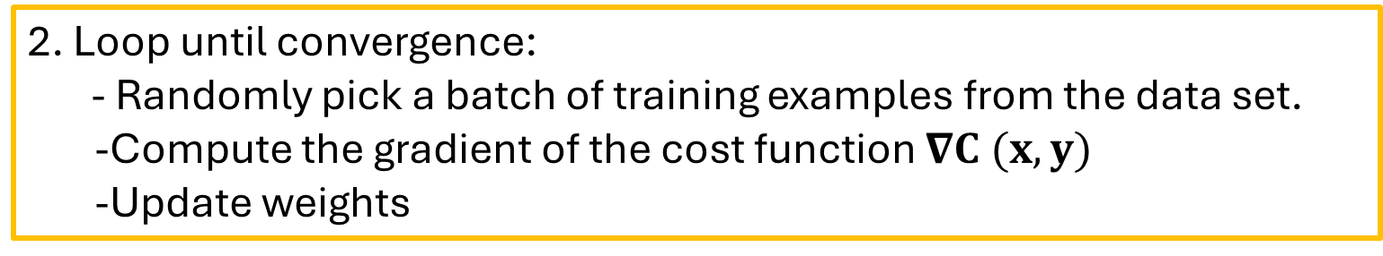
Mini Gradient Descent
1. Initialize weights $w$ randomly
2. Loop until convergence:
- Randomly pick a batch of training examples from the data set.
-Compute the gradient of the cost function $∇C (x, y)$
-Update weights
3. Return weights

Slide 18
Mini Batch Gradient Descent
In Mini-Batch Gradient Descent, only a subset or a mini-batch of training examples are used to compute the gradient and update the weights and biases of the neural network.
Thus, Mini-Batch gradient Descent strikes a balance between the goodness of Gradient Descent and speed of Stochastic Gradient Descent.

Slide 19
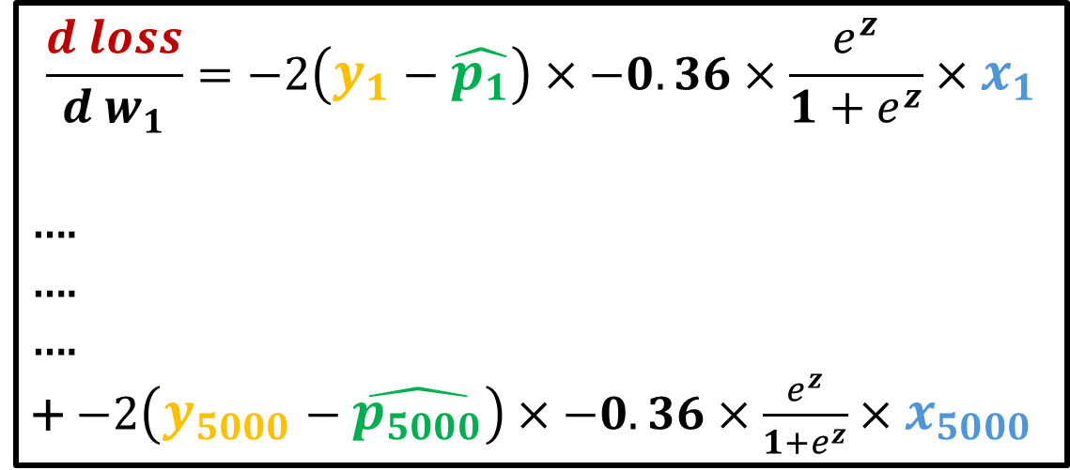
Mini Batch Gradient Descent
Epoch 1
$$\frac{d loss}{{d w}_{1}}=−2\left(y_{1}−\hat{p_{1}}\right)×−0.36×\frac{e^{z}}{1+e^{z}}×x_{1}$$
….
….
….
+ $−2\left(y_{5000}−\hat{p_{5000}}\right)×−0.36×\frac{e^{z}}{1+e^{z}}×x_{5000}$
Dosage $$x_{i}$$ | Effectiveness $y_{i}$ | Prediction $$\hat{p_{i}}$$
$$x_{1}$$ | $$y_{1}$$ | $$\hat{p_{1}}$$
$$x_{1000}$$ | $$y_{1000}$$ | $$\hat{p_{1000}}$$
$$x_{5000}$$ | $$y_{5000}$$ | $$\hat{p_{5000}}$$
$$x_{7500}$$ | $$y_{7500}$$ | $$\hat{p_{7500}}$$
$$x_{10000}$$ | $$y_{10000}$$ | $$\hat{p_{10000}}$$

Slide 20
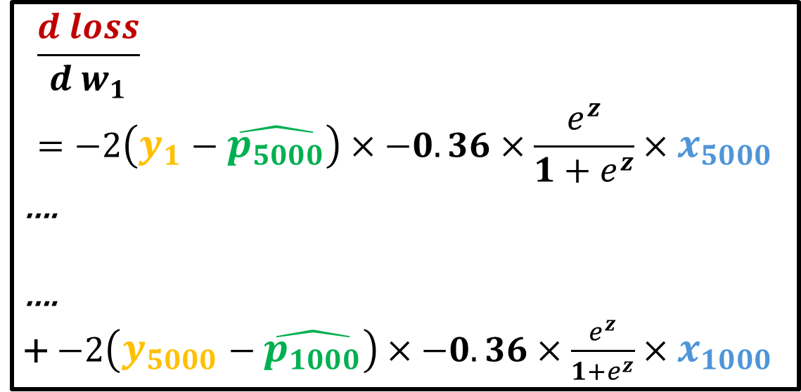
Mini Batch Gradient Descent
Epoch 2
$$\frac{d loss}{{d w}_{1}}=−2\left(y_{1}−\hat{p_{5000}}\right)×−0.36×\frac{e^{z}}{1+e^{z}}×x_{5000}$$
….
….
+ $−2\left(y_{5000}−\hat{p_{1000}}\right)×−0.36×\frac{e^{z}}{1+e^{z}}×x_{1000}$
Dosage $$x_{i}$$ | Effectiveness $y_{i}$ | Prediction $$\hat{p_{i}}$$
$$x_{1}$$ | $$y_{1}$$ | $$\hat{p_{1}}$$
$$x_{1000}$$ | $$y_{1000}$$ | $$\hat{p_{1000}}$$
$$x_{5000}$$ | $$y_{5000}$$ | $$\hat{p_{5000}}$$
$$x_{7500}$$ | $$y_{7500}$$ | $$\hat{p_{7500}}$$
$$x_{10000}$$ | $$y_{10000}$$ | $$\hat{p_{10000}}$$

Slide 21
 | Gradient Descent (Batch) | Stochastic Gradient Descent | Mini-Batch Gradient Descent
Dataset Usage | Uses the entire dataset (batch) at each iteration. | Uses a single random sample or a small batch of samples at each iteration. | Uses a subset or mini-batch of the dataset (batch) at each iteration.
Noise | Low noise as it updates parameters using all data points. | High noise due to frequent updates with a single or few samples. | Can be less noisy depending on the batch size

